Slide 1
CHAPTER 19
NEURAL NETWORK MATLAB TOOLBOX
“Principles of Soft Computing, 2nd Edition”
by S.N. Sivanandam & SN Deepa
Copyright © 2011 Wiley India Pvt. Ltd. All rights reserved.

Slide 2
NEURAL NETWORK TOOLBOX
The Matlab neural network toolbox provides a complete set of functions and a graphical user interface for the design, implementation, visualization, and simulation of neural networks.
It supports the most commonly used supervised and unsupervised network architectures and a comprehensive set of training and learning functions.
“Principles of Soft Computing, 2nd Edition”
by S.N. Sivanandam & SN Deepa
Copyright © 2011 Wiley India Pvt. Ltd. All rights reserved.

Slide 3
KEY FEATURES
Graphical user interface (GUI) for creating, training, and simulating your neural networks.
Support for the most commonly used supervised and unsupervised network architectures.
A comprehensive set of training and learning functions.
A suite of Simulink blocks, as well as documentation and demonstrations of control system applications.
Automatic generation of Simulink models from neural network objects.
Routines for improving generalization.
“Principles of Soft Computing, 2nd Edition”
by S.N. Sivanandam & SN Deepa
Copyright © 2011 Wiley India Pvt. Ltd. All rights reserved.

Slide 4
GENERAL CREATION OF NETWORK
net = network
net= network(numInputs,numLayers,biasConnect,inputConnect,layerConnec,outputConnect,targetConnect)
Description
NETWORK creates new custom networks. It is used to create networks that are then customized by functions such as NEWP, NEWLIN, NEWFF, etc.
“Principles of Soft Computing, 2nd Edition”
by S.N. Sivanandam & SN Deepa
Copyright © 2011 Wiley India Pvt. Ltd. All rights reserved.

Slide 5
NETWORK takes these optional arguments (shown with default values):
numInputs - Number of inputs, 0.
numLayers - Number of layers, 0.
biasConnect - numLayers-by-1 Boolean vector, zeros.
inputConnect - numLayers-by-numInputs Boolean matrix, zeros.
layerConnect - numLayers-by-numLayers Boolean matrix, zeros.
outputConnect - 1-by-numLayers Boolean vector, zeros.
targetConnect - 1-by-numLayers Boolean vector, zeros, and returns,
NET - New network with the given property values.
“Principles of Soft Computing, 2nd Edition”
by S.N. Sivanandam & SN Deepa
Copyright © 2011 Wiley India Pvt. Ltd. All rights reserved.

Slide 6
TRAIN AND ADAPT
Incremental training : updating the weights after the presentation of each single training sample.
Batch training : updating the weights after each presenting the complete data set.
When using adapt, both incremental and batch training can be used . When using train on the other hand, only batch training will be used, regardless of the format of the data. The big plus of train is that it gives you a lot more choice in training functions (gradient descent, gradient descent w/ momentum, Levenberg-Marquardt, etc.) which are implemented very efficiently .
“Principles of Soft Computing, 2nd Edition”
by S.N. Sivanandam & SN Deepa
Copyright © 2011 Wiley India Pvt. Ltd. All rights reserved.

Slide 7
The difference between train and adapt: the difference between passes and epochs. When using adapt, the property that determines how many times the complete training data set is used for training the network is called net.adaptParam.passes. Fair enough. But, when using train, the exact same property is now called net.trainParam.epochs.
>> net.trainFcn = 'traingdm';
>> net.trainParam.epochs = 1000;
>> net.adaptFcn = 'adaptwb';
>> net.adaptParam.passes = 10;
“Principles of Soft Computing, 2nd Edition”
by S.N. Sivanandam & SN Deepa
Copyright © 2011 Wiley India Pvt. Ltd. All rights reserved.

Slide 8
TRAINING FUNCTIONS
There are several types of training functions:
Supported training functions,
Supported learning functions,
Transfer functions,
Transfer derivative functions,
Weight and bias initialize functions,
Weight derivative functions.
“Principles of Soft Computing, 2nd Edition”
by S.N. Sivanandam & SN Deepa
Copyright © 2011 Wiley India Pvt. Ltd. All rights reserved.

Slide 9
SUPPORTED TRAINING FUNCTIONS
trainb – Batch training with weight and bias learning rules
trainbfg – BFGS quasi-Newton backpropagation
trainbr – Bayesian regularization
trainc – Cyclical order incremental update
traincgb – Powell-Beale conjugate gradient backpropagation
traincgf – Fletcher-Powell conjugate gradient backpropagation
traincgp – Polak-Ribiere conjugate gradient backpropagation
traingd – Gradient descent backpropagation
traingda – Gradient descent with adaptive learning rate backpropagation
traingdm – Gradient descent with momentum backpropagation
traingdx – Gradient descent with momentum & adaptive linear ackpropagation
trainlm – Levenberg-Marquardt backpropagation
trainoss – One step secant backpropagations
trainr – Random order incremental update
trainrp – Resilient backpropagation (Rprop)
trains – Sequential order incremental update
trainscg – Scaled conjugate gradient backpropagation
“Principles of Soft Computing, 2nd Edition”
by S.N. Sivanandam & SN Deepa
Copyright © 2011 Wiley India Pvt. Ltd. All rights reserved.

Slide 10
SUPPORTED LEARNING FUNCTIONS
learncon – Conscience bias learning function
learngd – Gradient descent weight/bias learning function
learngdm – Gradient descent with momentum weight/bias learning function
learnh – Hebb weight learning function
learnhd – Hebb with decay weight learning rule
learnis – Instar weight learning function
learnk – Kohonen weight learning function
learnlv1 – LVQ1 weight learning function
learnlv2 – LVQ2 weight learning function
learnos – Outstar weight learning function
learnp – Perceptron weight and bias learning function
learnpn – Normalized perceptron weight and bias learning function
learnsom – Self-organizing map weight learning function
learnwh – Widrow-Hoff weight and bias learning rule
“Principles of Soft Computing, 2nd Edition”
by S.N. Sivanandam & SN Deepa
Copyright © 2011 Wiley India Pvt. Ltd. All rights reserved.

Slide 11
TRANSFER FUNCTIONS
compet - Competitive transfer function.
hardlim - Hard limit transfer function.
hardlims - Symmetric hard limit transfer function.
logsig - Log sigmoid transfer function.
poslin - Positive linear transfer function.
purelin - Linear transfer function.
radbas - Radial basis transfer function.
satlin - Saturating linear transfer function.
satlins - Symmetric saturating linear transfer function.
softmax - Soft max transfer function.
tansig - Hyperbolic tangent sigmoid transfer function.
tribas - Triangular basis transfer function.
“Principles of Soft Computing, 2nd Edition”
by S.N. Sivanandam & SN Deepa
Copyright © 2011 Wiley India Pvt. Ltd. All rights reserved.

Slide 12
TRANSFER DERIVATIVE FUNCTIONS
Dhardlim - Hard limit transfer derivative function.
dhardlms - Symmetric hard limit transfer derivative function
dlogsig - Log sigmoid transfer derivative function.
dposlin - Positive linear transfer derivative function.
dpurelin - Hard limit transfer derivative function.
dradbas - Radial basis transfer derivative function.
dsatlin - Saturating linear transfer derivative function.
dsatlins - Symmetric saturating linear transfer derivative function.
dtansig - Hyperbolic tangent sigmoid transfer derivative function.
dtribas - Triangular basis transfer derivative function.
“Principles of Soft Computing, 2nd Edition”
by S.N. Sivanandam & SN Deepa
Copyright © 2011 Wiley India Pvt. Ltd. All rights reserved.

Slide 13
WEIGHT AND BIAS INITIALIZATION FUNCTIONS
initcon - Conscience bias initialization function.
initzero - Zero weight/bias initialization function.
midpoint - Midpoint weight initialization function.
randnc - Normalized column weight initialization function.
randnr - Normalized row weight initialization function.
rands - Symmetric random weight/bias initialization function.
WEIGHT DERIVATIVE FUNCTIONS
ddotprod - Dot product weight derivative function.
“Principles of Soft Computing, 2nd Edition”
by S.N. Sivanandam & SN Deepa
Copyright © 2011 Wiley India Pvt. Ltd. All rights reserved.

Slide 14
NEURAL NETWORK TOOLBOX GUI
The graphical user interface (GUI) is designed to be simple and user friendly. This tool lets you import potentially large and complex data sets.
The GUI also enables you to create, initialize, train, simulate, and manage the networks. It has the GUI Network/Data Manager window.
The window has its own work area, separate from the more familiar command line workspace. Thus, when using the GUI, one might "export" the GUI results to the (command line) workspace. Similarly to "import" results from the command line workspace to the GUI.
Once the Network/Data Manager is up and running, create a network, view it, train it, simulate it and export the final results to the workspace. Similarly, import data from the workspace for use in the GUI.
“Principles of Soft Computing, 2nd Edition”
by S.N. Sivanandam & SN Deepa
Copyright © 2011 Wiley India Pvt. Ltd. All rights reserved.

Slide 15
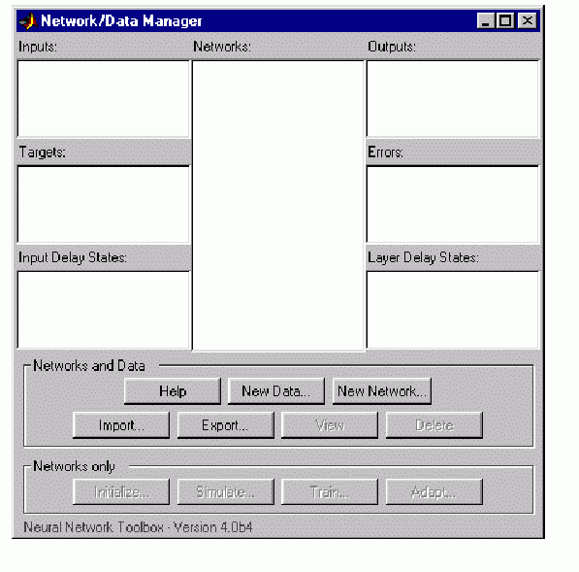
“Principles of Soft Computing, 2nd Edition”
by S.N. Sivanandam & SN Deepa
Copyright © 2011 Wiley India Pvt. Ltd. All rights reserved.

Slide 16
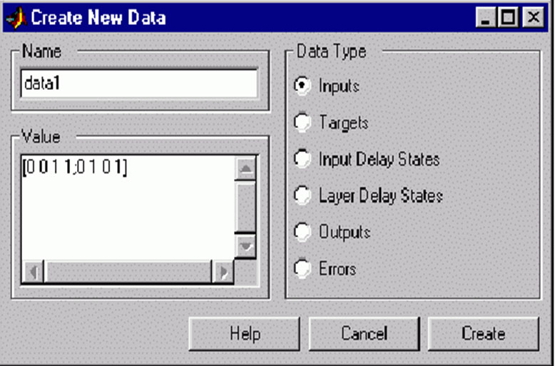
“Principles of Soft Computing, 2nd Edition”
by S.N. Sivanandam & SN Deepa
Copyright © 2011 Wiley India Pvt. Ltd. All rights reserved.

Slide 17
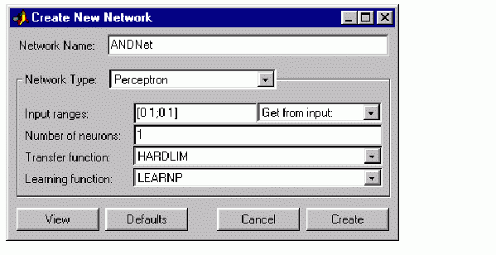
“Principles of Soft Computing, 2nd Edition”
by S.N. Sivanandam & SN Deepa
Copyright © 2011 Wiley India Pvt. Ltd. All rights reserved.

Slide 18
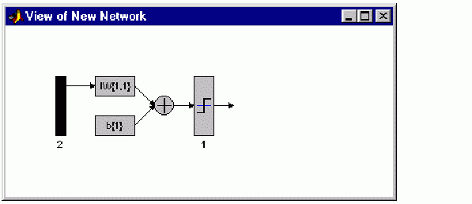
“Principles of Soft Computing, 2nd Edition”
by S.N. Sivanandam & SN Deepa
Copyright © 2011 Wiley India Pvt. Ltd. All rights reserved.

Slide 19
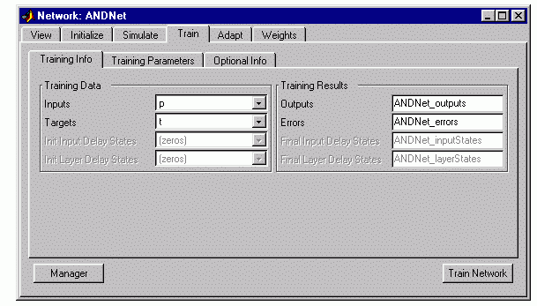
“Principles of Soft Computing, 2nd Edition”
by S.N. Sivanandam & SN Deepa
Copyright © 2011 Wiley India Pvt. Ltd. All rights reserved.

Slide 20
A graphical user interface can thus be used to
Create network,
Create data,
Train the networks,
Export the networks,
Export the data to the command line workspace.
“Principles of Soft Computing, 2nd Edition”
by S.N. Sivanandam & SN Deepa
Copyright © 2011 Wiley India Pvt. Ltd. All rights reserved.

Slide 21
CONCLUSION
The presentation has given an overview of Neural Network tool box in MATLAB.
“Principles of Soft Computing, 2nd Edition”
by S.N. Sivanandam & SN Deepa
Copyright © 2011 Wiley India Pvt. Ltd. All rights reserved.

